Slide 1
ETF Regression project
Preliminary findings and next steps

Slide 2
Project status at Checkpoint 1
Checkpoint 1 includes a system designed to perform a regression analysis between an initial group of ETFs and individual managers or the overall fund. The system ingests a consolidated vertically stacked data set of daily ETF, manager, and fund “levels”, pushes this data through a Python based stats engine, and outputs a regression that includes visualizations, summary statistics, and a correlation matrix.
The system is designed with scalability in mind. This means that we are free to add as many ETFs and other returns of interest to our source data without loss in computational performance and this translates directly to conducting data exploration and generating insights in a free-form and rapid manner.
The four slides that follow capture the initial findings when PAR’s ROEs were regressed against ETF returns. Although this is a narrow cross section, the system’s scalability allows us to instantly re-run these visualizations and summary stats for any ETF (explanatory variable) and ROE (dependent variable) pair.

Slide 3
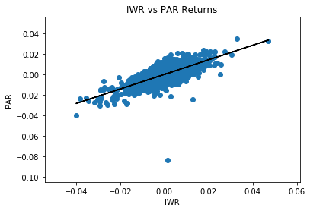
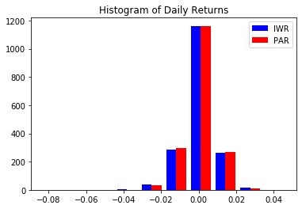

Strongest regression – par vs iwr

Slide 4
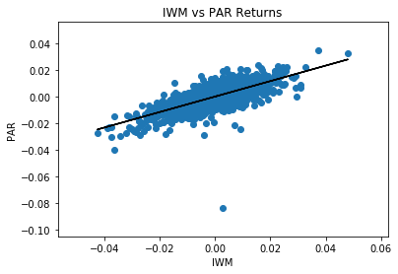
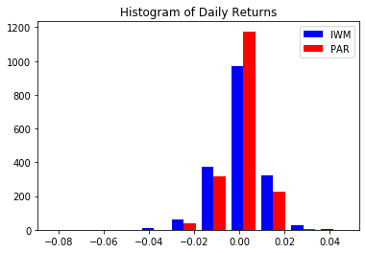
Second strongest regression – par vs iwm

Slide 5
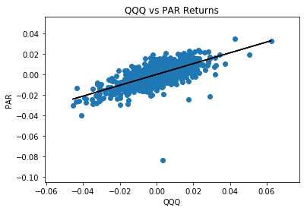
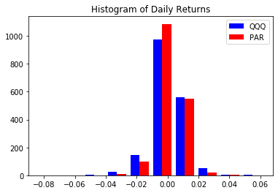

Second weakest regression – par vs qqq

Slide 6
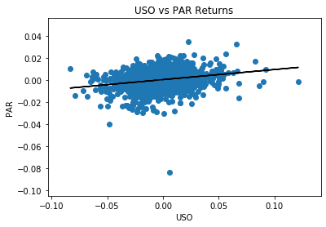
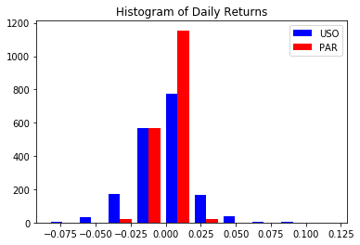

Weakest regression – par vs uso

Slide 7
Next steps
Refactor the initial system design
Tweak correlation matrix function arguments so that the Python output matches Excel derived correlation values.
Lock down data cleansing and data conformity features in the ingestion process to improve overall system stability.
Expand analytical breadth
Evolve the current system design from a static cross-sectional analysis to a dynamic time varying analysis. This will improve our confidence level in regression parameter stability and utilization.
Generate linear combination – algorithmically and manually derived – of ETF returns (composite ETFs).
Automatically rank order and report regression parameters across all ETFs – both individual and composite ETFs – on a cross-sectional and time-variant basis.
Imbed forecasting features (explanatory models and time series models) with associated model performance diagnostics.
Enable transparency
Research various user interface platforms that will work with Python based code, visualizations, and table outputs.
Migrate beta code to selected UI platform and develop a UI-enable beta version.

